Slide 1
Definition of Tree
A tree is a finite set of one or more nodes
such that:
There is a specially designated node called
the root.
The remaining nodes are partitioned into n>=0 disjoint sets T1, ..., Tn, where each of these sets is a tree.
We call T1, ..., Tn the subtrees of the root.

Slide 2
Tree – Terminology
Root : The basic node of all nodes in the tree.
Child : a successor node connected to a node is called child. ( B and C are child nodes to the node A, Like that D and E are child nodes to the node B. )
Parent : a node is said to be parent node to all its child nodes. ( A is parent node to B,C and B is parent node to the nodes D and F).
Leaf : a node that has no child nodes. ( D, E and F are Leaf nodes )
Siblings : Two nodes are siblings if they are children to the same parent node.
Ancestor : a node which is parent of parent node ( A is ancestor node to D,E and F ).
Descendent : a node which is child of child node ( D, E and F are descendent nodes of node A )
Degree : The number of sub tree of a node. A binary tree is degree 2.

Slide 3
Tree – Terminology
Level : The distance of a node from the root node, The root is at level – 0,( B and C are at Level 1 and D, E, F have Level 2.
Depth or height: of a tree is the maximum number of nodes in a branch of T. this turns out to be 1 more than the largest level number of T.
Edge: The line drawn from a node N of T to a successor is called an edge.
Path: A sequence of consecutive edges is called path.
A forest is a disjoint union of trees.

Slide 4
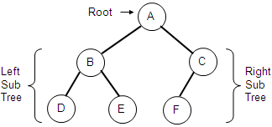
EXAMPLE

Slide 5
Binary Tree
A binary tree is a finite set of elements that is either empty or is partitioned into three disjoint subsets.
The first subset contains a single element called the root of the tree.
The other two subsets are themselves binary trees, called the left and right subtrees of the original tree. A left or right subtree can be empty. Each element of a tree is called a node of the tree.
A
Binary tree
B
c
E
D
F
G
H
I

Slide 6
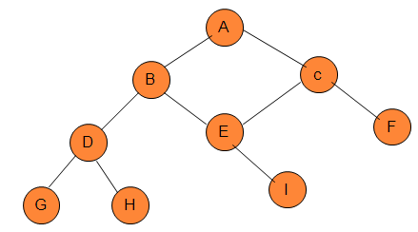
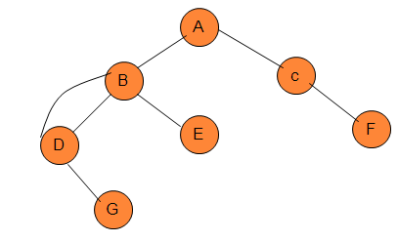
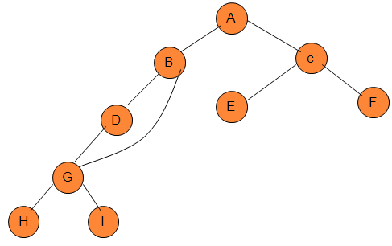
Structures that are not binary trees

Slide 7
Types of binary tree
Strictly binary trees
Complete binary tree
Extended binary tree

Slide 8
Strictly binary trees
If every non-leaf node in a binary tree must have two subtree left and right sub-trees, the tree is called a strictly binary tree.
A strictly binary tree with n leaves always contains 2n -1 nodes.
Here, B,E,F,G are leaf nodes. So n=4, No. of nodes=2*4-1=7
A
B
C
D
E
F
G

Slide 9
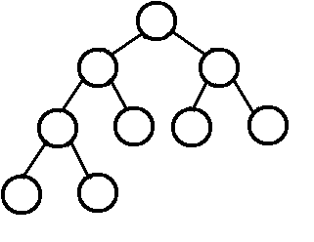
complete binary tree
The tree is said to be complete binary tree if all its levels, except possibly the last, have the maximum number of possible nodes and if all the nodes at last level appear as far left as possible.
Maximum number of nodes at any level r =2^{r}
Eq:- at level 0 maximum number of nodes=2º=1
At level 2 maximum number of nodes=2²=4 and so on.
.

Slide 10
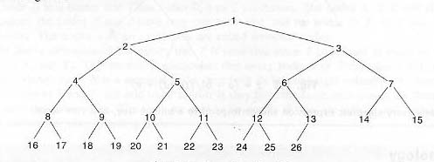
complete binary tree
Suppose given a complete binary tree having 26 nodes. We are labeling the nodes from 1 to 26.
Left child of node k=2*K
Right child of node k=2*K+1
Parent of node K=[K/2]
Depth of complete binary tree T_{n} with n node
D _{n} = [log ₂n +1]

Slide 11
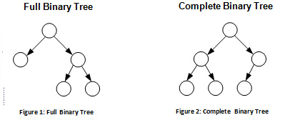
Full binary tree Vs Complete binary tree

Slide 12
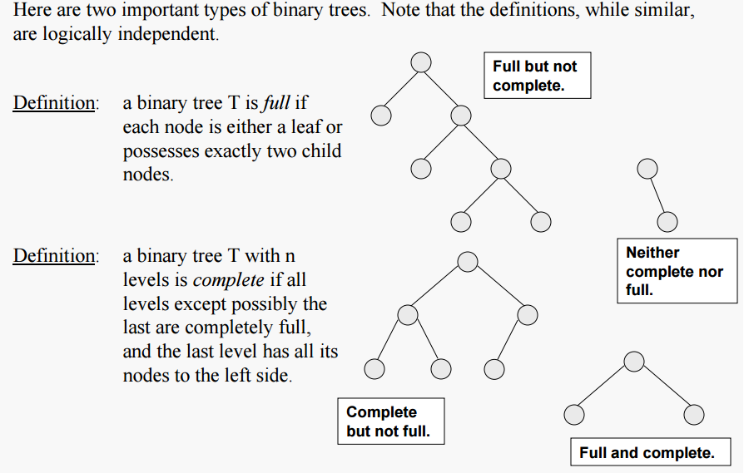
Full vs. complete binary tree

Slide 13
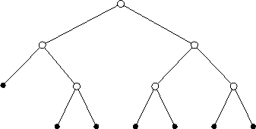
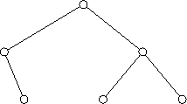
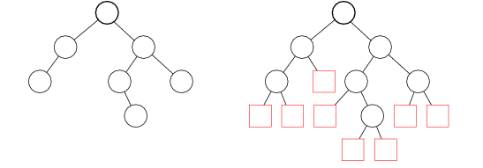
example
a
b

Slide 14
Representation of binary trees in memory
.
Array Representation
Linked Representation

Slide 15
Array representation
.
Tree Nodes are stored in the array.
Root node is stored at index ‘0’
If a node is at a location ‘i’, then its
    left child is located at 2 * i + 1
    right child is located at 2 * i + 2
This storage is efficient when it is a complete binary tree, because a lot of memory is wasted.

Slide 16
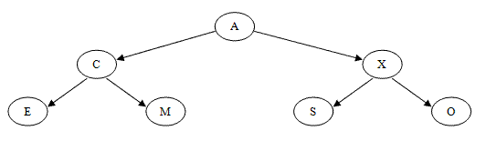
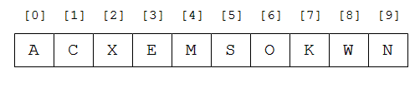
Example 1

Slide 17
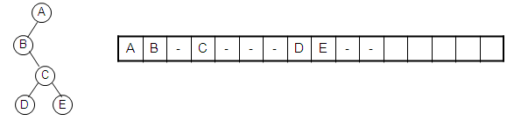
Example 2
Disadvantages
(1) waste space
(2) insertion/deletion
problem

Slide 18
Linked Representation
If a binary tree is not complete , a better choice for storing it is to use a linked representation.
It uses three array INFO, RIGHT, LEFT, and a pointer variable ROOT as follows.
First of all, each node N of tree T will correspond to a location K such that:
INFO[K] contains the data at node N.
RIGHT[K] contains the location of the right child of node N.
LEFT[K] contains the location of the left child of node N.
ROOT will contain the location of the root R of T.

Slide 19
Linked Representation
struct node {
int info;
struct node *left;
struct node *right;
};
info
Left
B
200
Root
Info
A
100
Right
C
500
left
right

Slide 20
Linked representation
ROOT
A
B
x C x
x D x
E x
x F x

Slide 21
Linked representation
1
2
3
4
5
6
7
8
9
10
A
3
6
ROOT
1
4
AVAIL
2
B
8
9
5
C
X
X
F
X
X
D
X
X
E
7
X

Slide 22
Traversing a binary tree
Three methods:
1. inorder
2. preorder
3. postorder
Inorder
1. Traverse the left subtree in inorder
2. Visit the root
3. Traverse the right subtree in inorder
Left-root-right
Preorder
1. Visit the root
2. Traverse the left subtree in preorder
3. Traverse the right subtree in preorder
Root-left-right
Postorder
1. Traverse the left subtree in postorder
2. Traverse the right subtree in postorder
3. Visit the root
Left-right-root

Slide 23
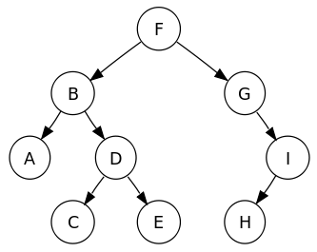
Traversing a binary tree
14
4
15
3
9
18
7
16
20
5
17

Slide 24
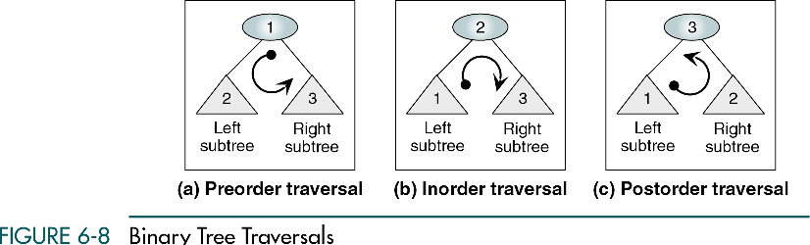

Slide 25
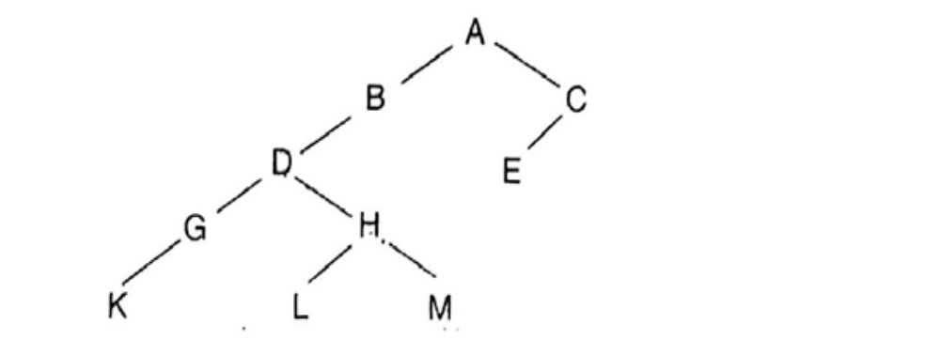
Traversing a binary tree
A
inorder: DGBAHEICF
preorder: ABDGCEHIF
postorder: GDBHIEFCA
B
C
D
E
F
G
H
I

Slide 26
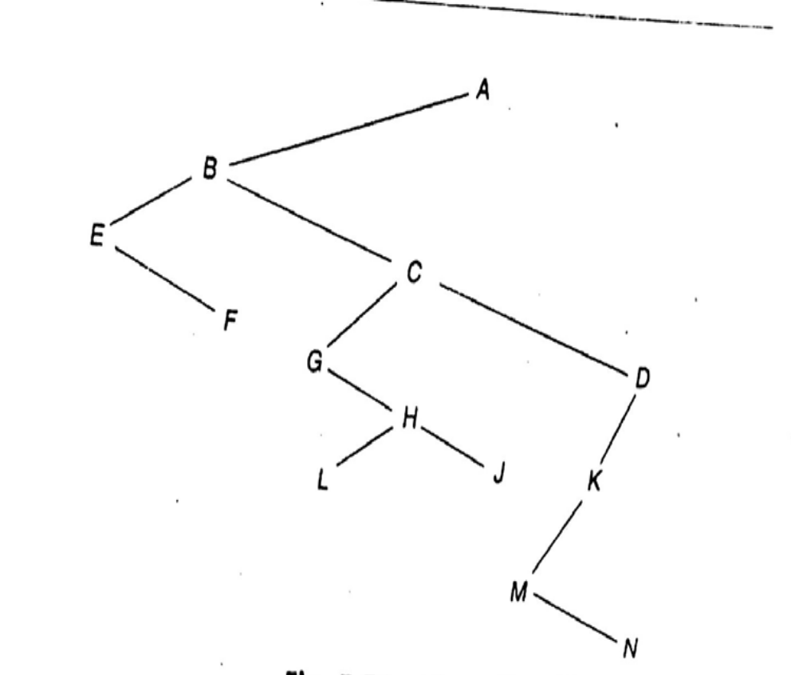
Traversing a binary tree
A
preorder: ABCEIFJDGHKL
inorder: EICFJBGDKHLA
postorder: IEJFCGKLHDBA
B
D
C
E
F
G
H
L
I
J
K

Slide 27
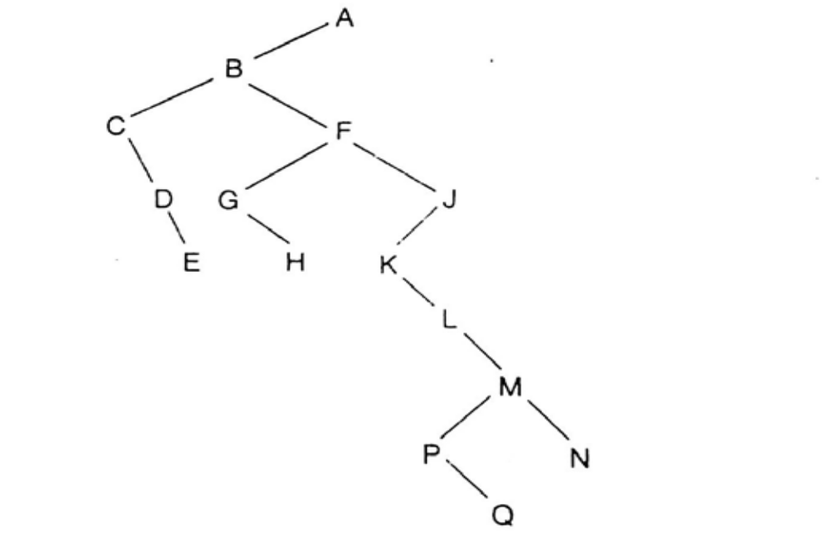

Slide 28
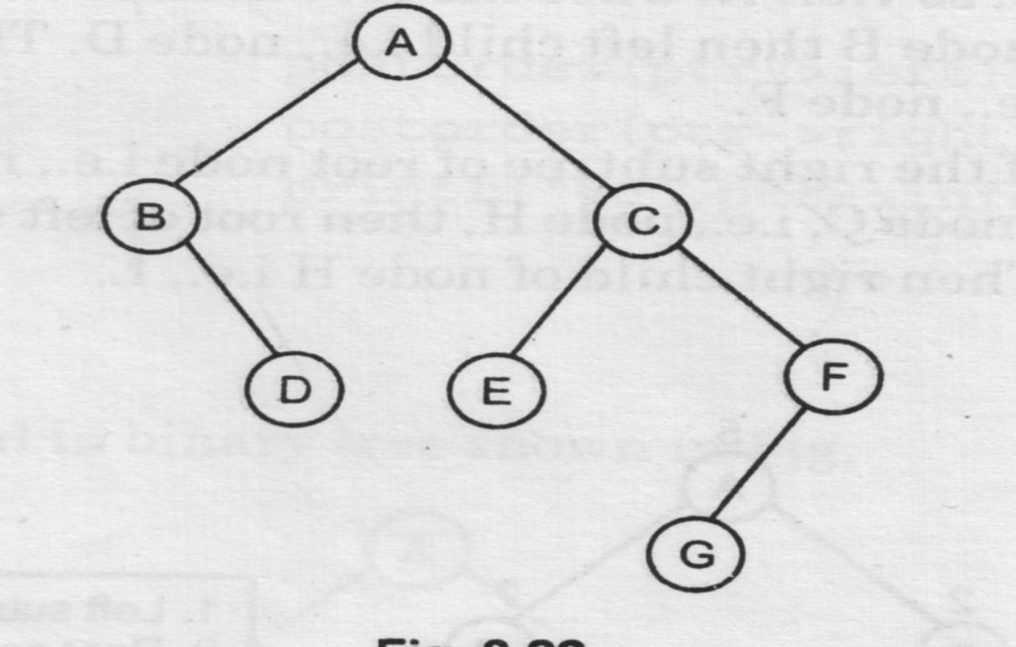
APPLY EACH TRAVERSAL IN BINARY TREE
PREORDER: ABDCEFG
INORDER: BDAECGF
POSTORDER: DBEGFCA

Slide 29
TRAVERSING
There are two solution for traversing
Recursive
Non-recursive

Slide 30
recursive traversal of binary tree

Slide 31
inorder
inorder (node *root)
{
if (root != NULL)
{
inorder (left[root]);
print (info[root]);
inorder (right[root]);
}
}

Slide 32
preorder
preorder (node *root)
{
if (root != NULL)
{
print (info[root]);
preorder (left[root]);
preorder (right[root]);
}
}

Slide 33
Post order
postorder (node *root)
{
if (root != NULL)
{
postorder (left[root]);
postorder (right[root]);
print (info[root]);
}
}

Slide 34
Int main()
{struct node *root;
Root=create();
Struct node* create()
{int x;
Struct node* new node;
New node=(struct node*)malloc(sizeof(struct node));
Printf(“enter data(-1 for no node)”);5
Scanf(“%d”,&x)
If(x=-1){ return 0;} new node->data=x;

Slide 35

CONSTRUCT TREE FROM GIVEN INORDER AND PREORDER TRAVERSALS
Let us consider the below traversals:
Inorder sequence: D B E A F C
Preorder sequence: A B D E C F
Solution: In a Preorder sequence, leftmost element is the root of the tree. So we know ‘A’ is root for given sequences. By searching ‘A’ in Inorder sequence, we can find out all elements on left side of ‘A’ are in left subtree and elements on right are in right subtree. So we know below structure now.

Slide 36
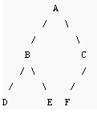
We recursively follow above steps and get the following tree.

Slide 37
CONSTRUCT TREE FROM GIVEN INORDER AND PREORDER TRAVERSALS
Inorder sequence: CAFDGHB
Preorder sequence: DACFBGH

Slide 38
SOLUTION
D
A
B
G
C
F
H

Slide 39
CONSTRUCT THE TREE FROM ITS GIVEN PREORDER AND POSTORDER
Construct the tree from its given preorder and postorder traversal. Explain the steps involved.
  Preorder: A B D G H K C E F
  Postorder: G K H D B E F C A

Slide 40
SOLUTION
The node appear in the first position preorder is always the root. So here, ‘A’ is the root.
A
Now, take one-one node from preorder and observe its position in postorder. Like here B is next in preorder. B is before A in postorder, so it child of A.
A
B

Slide 41
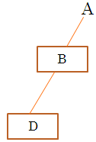
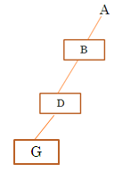
Next node in preorder is D. D is before B in postorder.
Next node in preorder is G. G is before D in postorder.

Slide 42
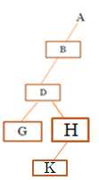
Next node in preorder is H. H is before D in postorder. But D is already having a left child. H will become right child of D.
H
Next node in preorder is K. K is before H in postorder.

Slide 43
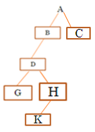
Next node in preorder is C . C is before A in postorder. But A is already having a left child. C will become right child of A.

Slide 44
Next node in preorder is E . E is before F in postorder. EF is before C in postorder.
E
F

Slide 45
In-order : 4, 2, 1, 7, 5, 8, 3, 6
Pre-order : 1, 2, 4, 3, 5, 7, 8, 6
In-order : 2, 5, 6, 10, 12, 14, 15
Pre-order : 10, 5, 2, 6, 14, 12, 15
In-order : T S Q A E D P M X C R F
Pre-order : P AS T Q E D X M R C F
In-order : 8 4 10 9 11 2 5 1 6 3 7
Pre-order : 1 2 4 8 9 10 11 5 3 6 7

Slide 46
Applications of Binary tree
Implementing routing table in router
Expression evaluation
To solve database problems such as indexing.
Data Compression code.

Slide 47
Tree traversal Applications
Pre-order
  Tree copying
  Counting the number of nodes
  Counting the number of leaves
  Prefix notation from a expression tree
Post-order
  Deleting a binary tree
  All stack oriented programming languages – mostly functional languages which fully works on nested functions.
  Calculator programs
  postfix notation in an expression tree – used in calculators
In-order
  we can extract the sorted values in a BST

Slide 48
Problem: Create a tree from the given traversals
preorder: F A E K C D H G B
inorder: E A C K F H D B G
Solution: The tree is drawn from the root as follows:
The root of tree is obtained by choosing the first node of preorder. Thus F is the root of the proposed tree
The left child of the tree is obtained as follows:
  Use the inorder traversal to find the nodes to the left and right of the root node selected from preorder. All nodes to the left of root node(in this case F) in inorder form the left subtree of the root(in this case E A C K )
  All nodes to the right of root node (in this case F ) in inorder form the right subtree of the root (H D B G)
  Follow the above procedure again to find the subsequent roots and their subtrees on left and right.

Slide 49
F is the root Nodes on left subtree( left of F):E A C K (from inorder)
Nodes on right subtree(right of F):H D B G(from inorder)
The root of left subtree:
From preorder: A E K C , Thus the root of left subtree is A
D H G B , Thus the root of right subtree is D
Creating left subtree first:
From inorder: elements of left subtree of A are: E (root of left)
elements of right subtree of A are: C K (root of right)
Thus tree till now is:
F
A D
E K
C
As K is to the left of C in preorder

Slide 50
Creating the right subtree of F
The root node is D
From inorder, the nodes on the left of D are: H (left root of D)
the nodes on the right of D are: B G (right root of D)
Thus the tree is:
F
A D
E K H G
C B

Slide 51
F
A D
E K H G
C B

Slide 52
Ex:
Draw the tree :
  Preorder: ABDGCEHIF
  Inorder: DGBAHEICF
  PostOrder: GDBHIEFCA

Slide 53
Pre-F,B,A,D,C,E,G,I,H
POST-A,C,E,D,B,H,I,G,F
PRE-1,2,4,5,3,6,8,9,7
POST-4,5,2,8,9,6,7,3,1
PRE-50,25,12,37,30,40,75,62,60,70,87
POST-12,30,40,37,25,60,70,62,87,75,50
PRE-V,W,B,C,Y,Z,N,A,M,L,P
POST-C,B,Z,N,Y,W,M,P,L,A,V

Slide 54
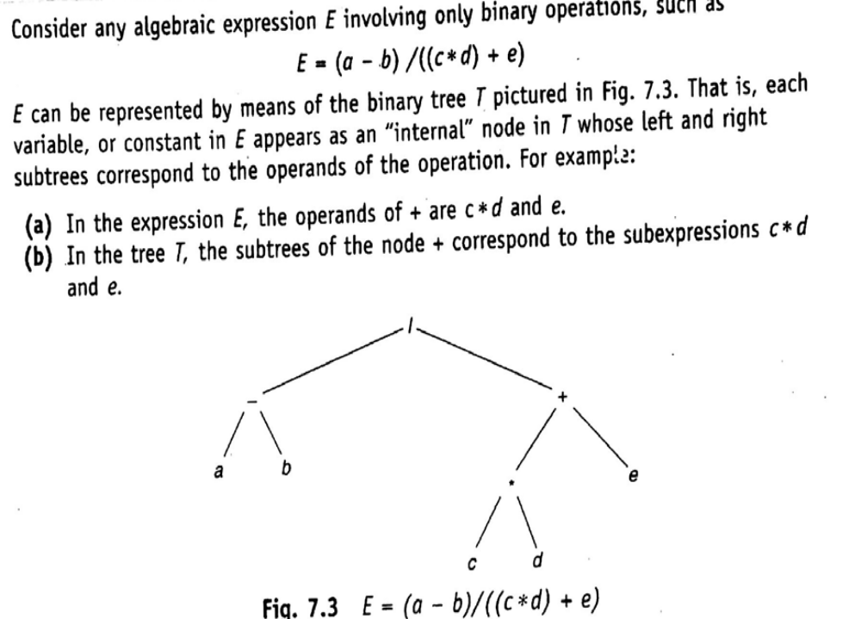

Slide 55
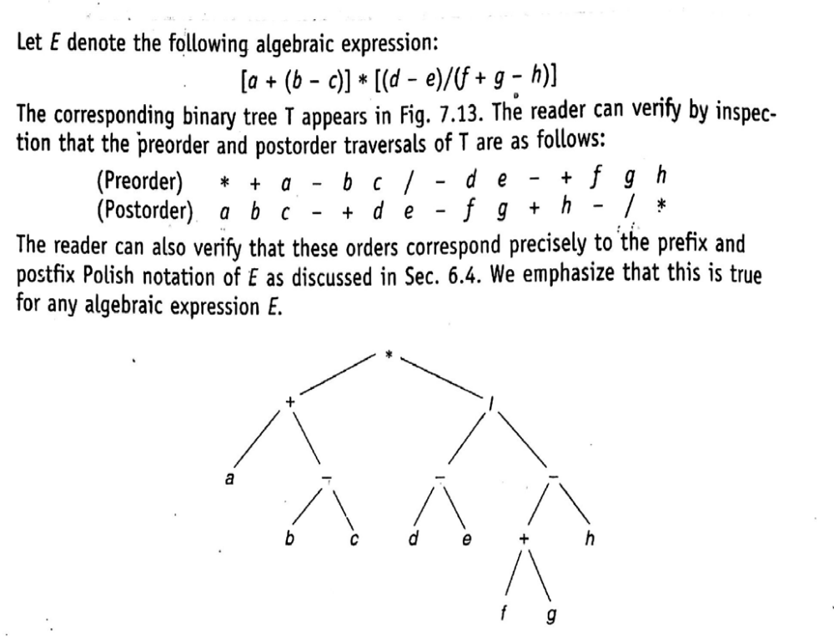

Slide 56
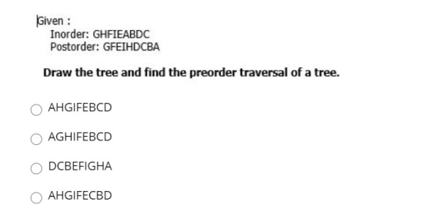

Slide 57
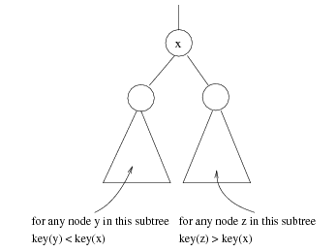
Binary Search Trees (BST)
A data structure for efficient searching, insertion and deletion.
Binary search tree property
  For every node X
  All the keys in its left
  subtree are smaller than
  the key value in X
  All the keys in its right
  subtree are larger than the
  key value in X

Slide 58

Binary Search Trees
A binary search tree
Not a binary search tree

Slide 59

Binary Search Trees
Average depth of a tree is O(log N)
Maximum depth of a tree is O(N)
The same set of keys may have different BSTs

Slide 60
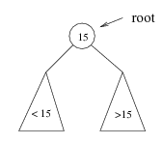
Searching BST
If we are searching for 15, then we are done.
If we are searching for a key < 15, then we should search in the left sub-tree.
If we are searching for a key > 15, then we should search in the right sub-tree.

Slide 61
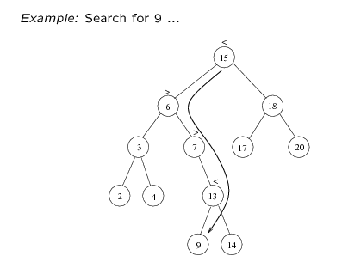
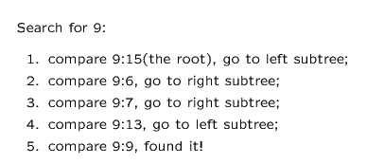

Slide 62
BST(searching)
FIND (INFO, LEFT, RIGHT, ROOT, ITEM, LOC, PAR)
If ROOT == NULL then: [tree empty]
Set LOC= NULL and PAR = NULL and return
2) If ITEM == ROOT →info , then: [item at root]
Set LOC = ROOT and PAR = NULL and return
If ITEM < ROOT →info , then: [intialize ptr and save]
Set PTR = ROOT →left and SAVE = ROOT
Else:
Set PTR = ROOT →right and SAVE = ROOT
[End of if statement]
4) Repeat step 5 and 6 while PTR≠NULL
If ITEM == PTR →info then: [item found]
  Set LOC = PTR and PAR = SAVE and return
If ITEM < PTR →info ,then:
Set SAVE = PTR and PTR = PTR →left
Else:
Set SAVE = PTR and PTR = PTR →right
[End of while loop at step 4]
7) Exit

Slide 63
BST(Insertion)
INSBST (INFO, LEFT, RIGHT, ROOT, AVAIL,
ITEM, LOC)
Call FIND(INFO,LEFT,RIGHT,ROOT,
ITEM,LOC,PAR)
2) a) if AVAIL==NULL then :
write OVERFLOW and exit
b) Set NEW = AVAIL, AVAIL = AVAIL→left and NEW →info = ITEM
c) NEW →left = NULL and NEW →right = NULL
3) If PAR==NULL then: [If tree is empty]
Set ROOT = NEW
else if: ITEM < PAR →info then: [If element < parent]
Set PAR →left = NEW
else : [If element > parent]
Set PAR →right = NEW
4) exit
Complexity of inserting Node in Binary Sear tree in worst case is O(n).
But the worst case complexity in balanced tree (AVL tree) is O(logn).

Slide 64
BST (Deletion)
CaseA (Info, Left, Right, Root, Loc, Par)
This procedure deletes node N at location Loc, where N doesn’t have 2 children. Par=Null → N is root node; Child=Null → N has no child
[Initilizes Child]
If Loc→left == Null and Loc→right == Null, then
Set Child = Null
Else if Loc→left ≠ Null, then
Set Child = Loc→left
Else
Set Child = Loc→right
  [End of if structure]
2) If Par ≠ Null, then
If Loc = Par→left, then Set Par→left = Child
Else Set Par→right = Child
  [End of if structure]
Else Set Root = Child
  [End of if structure]
3) Return

Slide 65
BST (Deletion)
CaseB(Info, Left, Right, Root, Loc, Par)
This procedure deletes node N at location Loc, where N has 2 children. Par=Null → N is root node; Suc → inorder successor, ParSuc → Parent of inorder successor
[Find Suc and ParSuc]
  Set Ptr = Loc→right and Save = Loc
  Repeat while Ptr→left ≠ Null
  Set Save = Ptr and Ptr = Ptr→left
  Set Suc = Ptr and ParSuc = Save
[Delete inorder successor using Procedure of CaseA]
Call CaseA (Info, Left, Right, Root, Suc, ParSuc)
[Replace Node N by its inorder successor]
  a) If Par ≠ Null, then
  If Loc == Par→left, then Set Par→left = Suc
  Else Set Par→right = Suc
  [End of if structure]
  Else Set Root = Suc
  [End of if structure]
  Set Suc→left = Loc→left and Suc→right = Loc→right
4) Return

Slide 66
Algorithm: DEL( INFO, LEFT,RIGHT,ROOT,AVAIL,ITEM)
This procedure deletes ITEM from the tree.
1) [Find the location of ITEM and it’s parent]
Call FIND(INFO,LEFT,RIGHT,ROOT,ITEM,LOC,PAR)
2) [ITEM in tree?]
If LOC == NULL, then:
write: ITEM not in tree, and exit
[End of if structure]
3) [Delete node containing ITEM]
If LOC→right ≠ NULL and LOC →left ≠ NULL, then:
Call CaseB( INFO, LEFT, RIGHT, ROOT, LOC, PAR)
Else:
Call CaseA( INFO, LEFT,RIGHT,ROOT,LOC,PAR)
[End of if structure]
4) [Return deleted node to the AVAIL list]
Set LOC→right = AVAIL and AVAIL = LOC
5) Exit.

Slide 67
Deletion in Binary Search Tree
struct node* deleteNode(struct node* root, int key)
{
// base case
if (root == NULL) return root;
// If the key to be deleted is smaller than the root's key,
// then it lies in left subtree
if (key < root->key)
root->left = deleteNode(root->left, key);
// If the key to be deleted is greater than the root's key,
// then it lies in right subtree
else if (key > root->key)
root->right = deleteNode(root->right, key);
// if key is same as root's key, then This is the node
// to be deleted
else
{

Slide 68
// node with only one child or no child
if (root->left == NULL)
{
struct node *temp = root->right;
free(root);
return temp;
}
else if (root->right == NULL)
{
struct node *temp = root->left;
free(root);
return temp;
}
// node with two children: Get the inorder successor (smallest
// in the right subtree)
struct node* temp = minValueNode(root->right);
// Copy the inorder successor's content to this node
root->key = temp->key;
// Delete the inorder successor
root->right = deleteNode(root->right, temp->key);
}
return root;
}

Slide 69
Application of BST
Storing a set of names, and being able to lookup based on a prefix of the name. (Used in internet routers.)

